Slide 1
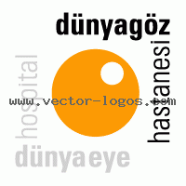
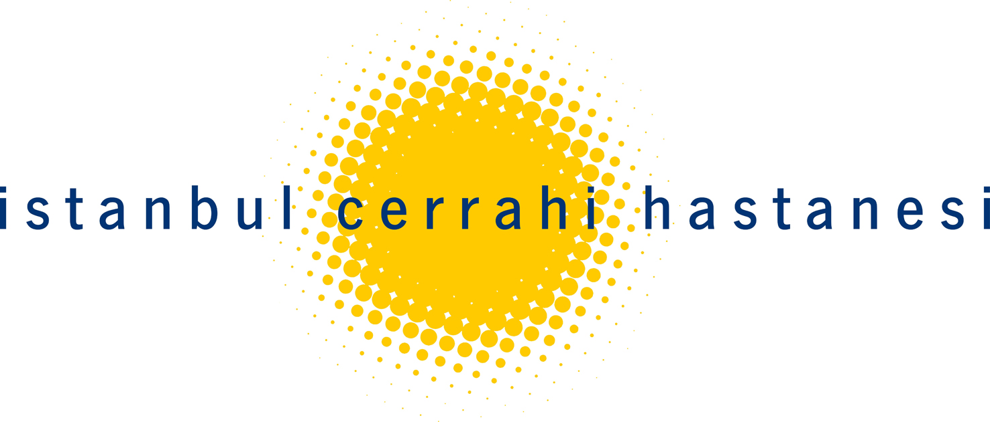
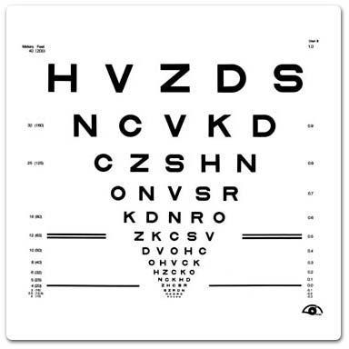
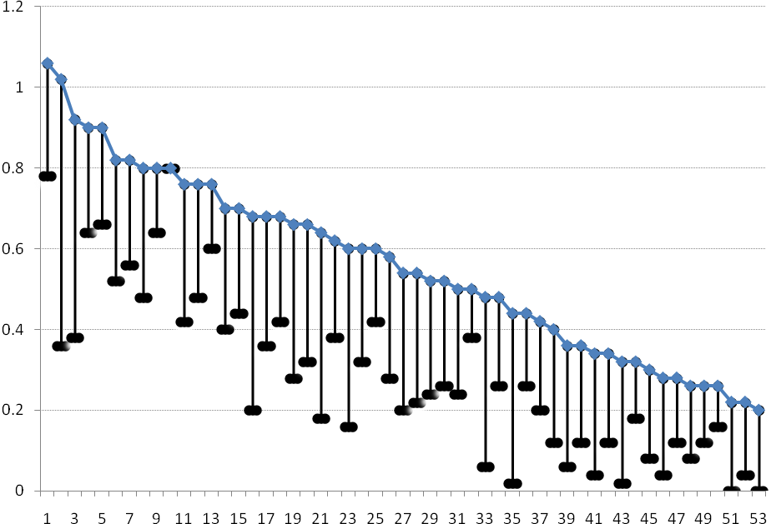
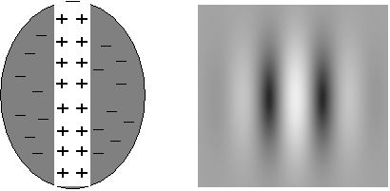
Efficacy of neural vision therapy to enhance visual acuity and contrast sensitivity function in amblyopia
Elvan Yalcin ¹, Funda Serefhan², Serap Azizoglu²
¹ Dunya Goz Hastanesi, Etiler, Istanbul / Turkey
² Istanbul Cerrahi Hastanesi, Nisantasi, Istanbul / Turkey
INTRODUCTION
Computer based cortical vision training (RevitalVision, Lawrence, KS USA) involves the use of server based software utilizing Gabor patch stimuli to enhance neuronal processing in the visual cortex. The purpose of this study was to evaluate the efficacy of the RevitalVision cortical vision training in enhancing Best Corrected Visual Acuity (BCVA) and Contrast Sensitivity Function (CSF) in amblyopic patients.
RevitalVision technology has been shown to improve visual acuity and CSF in low myopes (Tan 2004; Tan 2005), early presbyopes (Tan 2006), post refractive surgical patients (Lim and Fam, 2006; Tan 2005a) and amblyopes (Polat, Ma-Naim et al. 2004). Amblyopia is a spatial vision disorder that affects about 3% of the population (McKee, Levi et al. 2003; Simmers, Ledgeway et al. 2003). It is characterized by a cortical impairment resulting from abnormal visual experience in early childhood, such as strabismus, anisometropia or both, however, the neural basis of amblyopia is not entirely clear (Kiorpes and McKee 1999; Barnes, Hess et al. 2001). Conventionally it was thought that visual development became hard-wired after the critical period of approximately 6 to 8 years of age. Recent studies suggest that perceptual learning might be a potential treatment for adult amblyopia (Chung, Levi, & Tan, 2005; Huang, Zhou, & Lu, 2008; Levi & Li, 2009a, 2009b;Levi & Polat, 1996; Levi, Polat, & Hu, 1997; Li & Levi, 2004; Polat, 2009; Polat, Ma-Naim,Belkin, & Sagi, 2004; Zhou et al., 2006).
In this study, we investigated the effect of the RevitalVision Treatment System on BCVA and contrast sensitivity in children and adult patients with amblyopia.
Our population of 53 amblyopes, with an age range between 8 and 50 years, was separated into four age groups (8 - 11yrs, N=14; 12-17yrs N=18; 18 - 30yrs, N=12 and 30yrs and above, N=12) to assess if efficiency of the treatment was effected by age. A one-way factorial ANOVA showed total improvement in BCVA with treatment was not significantly different across age groups.
Mean treatment time was 4 months. Mean number of treatment sessions was 58 ±14 (range 42 to 87). After baseline assessment, patients revisited approximately every 15 to 20 sessions. The total number of treatments significantly correlated with total improvement of BCVA p< .028 level, indicating more therapy sessions equaled larger overall gain in BCVA.
The different forms of amblyopia, strabismic (N=7), anisometropic (N=6), mixed (N=40) and iatrogenic (N=3) were also compared to understand if the therapy works better in a particular type of amblyopia. There were only 3 individuals with iatrogenic amblyopia; therefore it was excluded from this analysis. The remaining amblyopia groups were analyzed using a one-way factorial ANOVA, showing that the difference was not significant amongst the groups.
BACKGROUD
Visual processing involves the integrated activity of neurons in the visual cortex. Neuronal responses and visual perception is determined by the signal to noise ratio of neuronal activity, whereby the visual cortex collects responses across many neurons to average out noisy activity of single cells to improve the signal to noise ratio, leading to improved visual interpretation and acuity (Geisler and Albrecht 1997). Studies have shown noise of individual neurons can be influenced so that the contrast sensitivity at low levels can be dramatically increased when appropriate stimulus parameters are used (Polat and Sagi 1993; Polat and Sagi 1994; Polat, Mizobe et al. 1998; Kasamatsu, Polat et al. 2001). The use of such stimulus to increase neuronal efficiency causes modifications in the visual cortex, which is the basis for ‘brain plasticity’ (Dosher and Lu 1998; Dosher and Lu 1999), whereby the brain adapts to change and acquires a new skill. In addition, repetitive performance of many basic tasks has demonstrated physical modifications in the adult cortex (Sagi and Tanne 1994; Gilbert 1998).
RevitalVision cortical vision training is a server-based, interactive system tailored and continuously adaptive to the individuals visual abilities. In the first stage, the subject is exposed to a set of visual perception tasks, aimed to analyze and identify each subject’s neural inefficiencies. The building block of these visual stimulations is the Gabor patch (Figure 1), which efficiently activates and matches the shape of receptive field in the visual cortex. The fundamental stimulation-control technique is called “Lateral Masking”, where collinearly oriented flanking Gabor’s are displayed in addition to the target Gabor image (Figure 2). The patient is exposed to two short displays in succession, in a random order; then the patient identifies which display contains the target Gabor image. The task is repeated and a staircase is applied until the patient reaches their visual threshold level. Based on this analysis, a treatment plan is initialized, and subject specificity is achieved by administering patient-specific stimuli in a controlled environment.
METHODOLOGY
A total of 53 individuals with unilateral naturally occurring strabismic, anisometropic, mixed (strabismic and anisometropic) and iatrogenic amplyopia (20.3 ± 11.5 years, range 8 to 50 years; 62% male), with a BCVA of between 1.06 logMar to 0.20 logMar (approximately 6/60 to 6/9.5 Snellen equivalent) were included in this study. All amblyopic visits constituted; cover test, prism cover test, logMar visual acuity (using EDTRS letters), stereovision (Random Dot stereopsis), worths four dot test, CSF (Stereo Optical Company, Functional Vision Analyser) and manifest cycloplegic refraction. If necessary, corrective glasses were prescribed and subject were instructed to wear them at waking hours, especially during the cortical vision training.
The treatment is applied in successive 30-minute sessions, administered 2-3 times a week, a total of approximately 60 sessions. Approximately every 15-20 sessions individuals are recalled for monitoring of their visual status. Visits generally comprise a total of 4 visits; including baseline, 1st visit, 2nd visit and treatment end. In the case where progress continued still at treatment end visit individuals were instructed to continue until progress in both visual acuity and/or CSF plateaud. In this case their treatment end data was used and the 3rd visit or 4th visit was not analyzed.
Figure 1: Distribution of BCVA gain from baseline to treatment end (x-amblyopic individual, y-axis logMar BCVA, black line equals total visual gain)
Figure 2: LogMar BCVA from baseline, 1st visit, 2nd visit and
treatment end with standard error bars.
CSF Improvement from
Baseline to Treatment End
Mean improvements of 75.5%, 68.7%, 52.2%, 42.2% and 27.5% was found in the 5 CSF levels respectively; A(1.5), B(3), C(6), D(12) and E(18) from baseline to treatment end. The 5 CSF levels were analyzed across the 4 time points; baseline, 1st visit, 2nd visit and treatment end, using repeated measures ANOVA. The two way interaction between time and CSF was significant, F(12,660) = 2.29, p<.007 (η² =.04). CSF significantly differed at the different time points. However, for most CSF levels the 2nd visit and treatment end did not significantly differ from each other, but baseline and 1st visit do significantly differ. In terms of the number of treatments and CSF, there numbers of treatment sessions were significantly correlated with improvement level; however, improvement of CSF was not influenced by age.
TREATMENT RESULTS
All 53 individuals completed the study and analysis showed there were statistical significant improvements in both BCVA and CSF post-treatment when compared to pre-treatment data.
Visual Acuity
BCVA in the amblyopic eyes increased an average of 50.8%, equivalent to a mean improvement of 2.6 EDTRS lines, 37.7% improved between 3.3 to 6.6 lines, 39.6% improved between 2.0 to 2.9 lines, 20.8% improved between 1.0 to 1.8 lines and one individual had no improvement or regression of BCVA in the amblyopic eye. Individual improvement of each individual is given in Figure 1. Total improvement of BCVA was not influenced by initial BCVA.
One-way Analysis of Variance (ANOVA) comparing baseline measures with the baseline data, 1st Visit, 2nd Visit and treatment end, showed a significant effect of time, F(3,156) = 173.38, p < .001 (η² =.77), indicating all four time points are significantly different from each other (Figure 2). A t-test was used to compare the level of improvement in BCVA in males and females, showing level of improvement not to be effected by gender t(54) = -.72, p=.48.
Figure 3: CSF from baseline, 1st visit, 2nd visit and treatment end with standard error bars. Gray area is CSF norms.
First Display
Second Display
CONCLUSION
Cortical vision training in amblyopia may improve BCVA and CSF.
REFERENCES
Ciuffreda K. J., Levi D. M., Selenow A. (1991). Amblyopia: Basic and clinical aspects. Boston: Butterworth-Heinemann.
Donald Tan, Bill Chan, Frederick Tey, Lionel Lee, Pilot Study To Evaluate The Efficacy of Neural Vision Correction™ (NVC™) Technology For Vision Improvement in Low Myopia, ARVO 2004
Donald Tan, Enhancement of Visual Acuity and Contrast Sensitivity in Low Myopes Through the Use of Neural Vision Correction (NVC) Technology Is Maintained Over One Year, APAO 2005
Donald Tan, Improving VA and CSF in Subjects with Low Degrees of Myopia and Early Presbyopia using Neural Vision Correction (NVC) Technology, APAO 2006
Donald Tan, What Is Still Lacking in Refractive Surgery Is the Role of Neuroprocessing, AAO 2005a
Barnes, G. R., R. F. Hess, et al. (2001). "The cortical deficit in humans with strabismic amblyopia." J Physiol 533(Pt 1): 281-97.
Dosher, B. A. and Z. L. Lu (1998). "Perceptual learning reflects external noise filtering and internal noise reduction through channel reweighting." Proc Natl Acad Sci U S A 95(23): 13988-93.
Dosher, B. A. and Z. L. Lu (1999). "Mechanisms of perceptual learning." Vision Res 39(19): 3197-221.
Geisler, W. S. and D. G. Albrecht (1997). "Visual cortex neurons in monkeys and cats: detection, discrimination, and identification." Vis Neurosci 14(5): 897-919.
Gilbert, C. D. (1998). "Adult cortical dynamics." Physiol Rev 78(2): 467-85.
Huang C. B., Zhou Y., Lu Z. L. (2008). Broad bandwidth of perceptual learning in the visual system of adults with anisometropic amblyopia. Proceedings of the National Academy of Science United States of America, 105, 4068–4073.
Kasamatsu, T., U. Polat, et al. (2001). "Colinear facilitation promotes reliability of single-cell responses in cat striate cortex." Exp Brain Res 138(2): 163-72.
Kiorpes, L. and S. P. McKee (1999). "Neural mechanisms underlying amblyopia." Curr Opin Neurobiol 9(4): 480-6.
Levi D. M., Li R. W.(2009a). Improving the performance of the amblyopic visual system. Philosophical Transactions of the Royal Society of London B: Biological Sciences, 364, 399–407.
Levi D. M., Li R. W. (2009b). Perceptual learning as a potential treatment for amblyopia: A mini-review. Vision Research, 49, 2535–2549.
Levi D. M., Polat U. (1996). Neural plasticity in adults with amblyopia. Proceedings of the National Academy of Science United States of America, 93, 6830–6834.
Levi D. M., Polat U., Hu Y. S.(1997). Improvement in Vernier acuity in adults with amblyopia Practice makes better. Investigative Ophthalmology and Vision Science, 38, 1493–1510.
Li R. W., Levi D. M.(2004). Characterizing the mechanisms of improvement for position discrimination in adult amblyopia. Journal of Vision, 4, (6):7, 476–487
McKee, S. P., D. M. Levi, et al. (2003). "The pattern of visual deficits in amblyopia." J Vis 3(5): 380-405.
Polat, U. (1999). "Functional architecture of long-range perceptual interactions." Spat Vis 12(2): 143-62.
Polat U. (2009). Making perceptual learning practical to improve visual functions. Vision Research, 49, 2566–2573
Polat, U., T. Ma-Naim, et al. (2004). "Improving vision in adult amblyopia by perceptual learning." Proc Natl Acad Sci U S A 101(17): 6692-7.
Polat, U., K. Mizobe, et al. (1998). "Collinear stimuli regulate visual responses depending on cell's contrast threshold." Nature 391(6667): 580-4.
Polat, U. and D. Sagi (1993). "Lateral interactions between spatial channels: suppression and facilitation revealed by lateral masking experiments." Vision Res 33(7): 993-9.
Polat, U. and D. Sagi (1994). "Spatial interactions in human vision: from near to far via experience-dependent cascades of connections." Proc Natl Acad Sci U S A 91(4): 1206-9.
Sagi, D. and D. Tanne (1994). "Perceptual learning: learning to see." Curr Opin Neurobiol 4(2): 195-9.
Simmers, A. J., T. Ledgeway, et al. (2003). "Deficits to global motion processing in human amblyopia." Vision Res 43(6): 729-38.
Zhou Y. F., Huang C. B., Xu P. J., Tao L. M., Qiu Z. P., Li X. R. (2006). Perceptual learning improves contrast sensitivity and visual acuity in adults with anisometropic amblyopia. Vision Research, 46, 739–750
Figure 1: The Gabor Patch
Figure 2: Lateral Masking images

